Slide 1
Investigation of Factors Affecting Daily Life Activities In Geriatric Patients
Mentor: Assoc. Dr. Pınar Soysal
Duygu Su Saraçoğlu

Slide 2
PLAN
Introduction
Purpose
Materiel&method
Statistical analysis
Results
Conclusion

Slide 3
Introduction
Every country in the world is experiencing growth in both the size and the proportion of older persons in the population
Globally, the population aged 65 and over is growing faster than all other age groups.
In 2019, 1 out of every 11 people was 65 years or older. This rate is expected to increase to 1 in 6 people by 2050.
World Population Prospects: the 2019 Revision
Notes:
populations around the world are rapidly ageing and this demographic transition will impact on almost all aspects of society
The number of
people aged 65 or older is projected to grow
from an estimated 524 million in 2010 to nearly
1.5 billion in 2050
Currently,
Chronic diseases such as
hearth diseases, diabetes, hypertension that more commonly
affect adults and older people impose the
greatest burden on global health. The potential economic and societal costs of
noncommunicable diseases of this type rise
sharply with age and have the ability to affect
economic growth.

Slide 4
According to the World Health Organization:
The number of older people who need support for activities of daily living in developing countries is forecast to quadruple by 2050.
There is an urgent need to develop and implement comprehensive and coordinated primary health care approaches that can prevent, slow or reverse decline in capacity drives through the chronic diseases.

Slide 5
PURPOSE
In studies, the increase in the coexistence of diseases seriously affects the decrease in functional capacity, that is, the independent living status of individuals. However, disability factors due to ageing are unknown.
We aimed to find out how much the functional capacities of geriatric patients are affected by diseases through an age classification

Slide 6
MATERİAL&METHOD
Data Source: We included patients who were admited to the Bezmialem University Hospital geriatric outpatient clinic between January 2019 and September 2020
Age classification: 60-70,70-80,80-90,90+
Demographic features: Age, gender, education year, number of drug used, comorbidities
Functional tests: Barthel Index for Activities of Daily Living and Lawton Instrumental Activities of Daily Living Scale
Diseases:
COMORBIDITIES
Hypertension
Coronary Artery Disease
Chronic Obstructive Lung Disease
Cerebrovascular disease
Chronic Heart Disease
Peripheric Vascular Disease
Dementia
Parkinson’s Disease
Osteoarthritis

Slide 7
Feeding
Bathing
Grooming
Dreessing
Bowels
Blader
Toilet use
Transfer
Mobility
Stairs
Points | Dependency level
0-20 | Fully dependent
21-61 | Highly dependent
62-90 | Moderately dependent
91-99 | Mildly dependent
100 | Fully independent
0-100

Slide 8
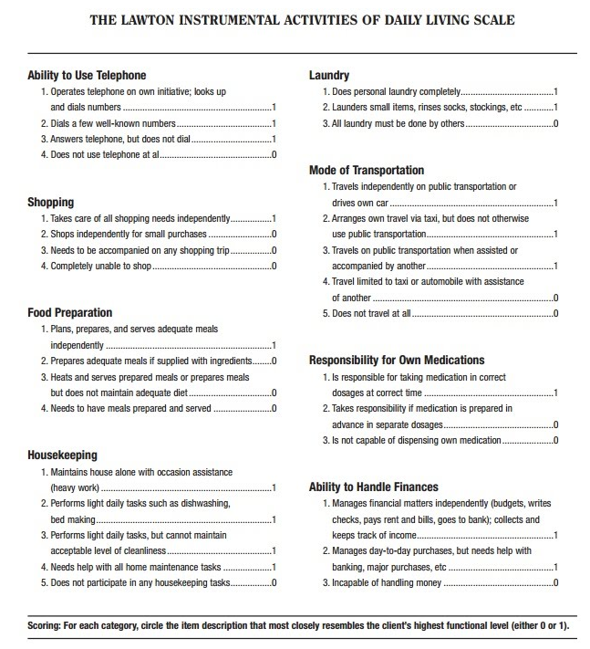
Ability of use telephone
Shopping
Food preperation
Housekeeping
Laundry
Mode of transportation
Responsibility of own medication
Ability to handle finances
Score | Dependency level
0-8 | Dependent
9-16 | Semi-dependent
17-23 | Independent
0-23

Slide 9
Inclusion& exclusion criteria
Inclusion criteria
65 and over
chronic diseases
who are volunteering to participate in research and having knowledge of daily life activitie
Exclusion criteria
Younger than 65 years of age
Individuals who have severe vision and hearing impairment that prevent communication and understanding commands during the examination
Individuals who refused to participate
Individuals who have terminal disease, a life-threatening disease in the last 6 months or those hospitalized for major surgery

Slide 10
ANALYSIS
IBM SPSS Statistics 22.0
Mean ± standard deviation, median and range of distribution
Mean and standard deviation were summarized and compared using t-test for age, and proportions were summarized and compared using chi square tests for the rest of the categorical variables.
Independent t test and Mann-Whitney U test (for small size sample groups) to comparison of continous variables in groups.
Comorbid diseases were classified according to the Satariano index.
The relationship between comorbid diseases and basic daily living activities and instrumental daily living activities scales was evaluated by logistic regression analysis.
Independent variable: Chronic diseases
Dependent variable: Degree of influence on activities of daily living (Bartel and Lawton activity of daily living test score)

Slide 11
RESULTS
Descriptive Statistics: 768 patients (%30,3 male, %69,7 female)
Age Groups
 | Mean | Std. Deviation
Age | 79,0844 | 7,61966
Education | 5,084 | 4,1852
Drug number | 6,26 | 3,334
Comorbidities | 2,0236 | 1,30075
 |  | Frequency | Percent | Valid Percent | Cumulative Percent
Valid | 60-70 | 107 | 13,9 | 13,9 | 13,9
 | 70-80 | 277 | 36,0 | 36,0 | 49,9
 | 80-90 | 331 | 43,0 | 43,0 | 92,9
 | 90+ | 55 | 7,1 | 7,1 | 100,0
 | Total | 770 | 100,0 | 100,0

Slide 12
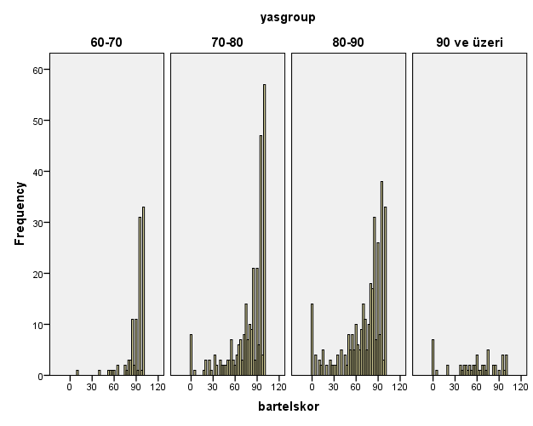
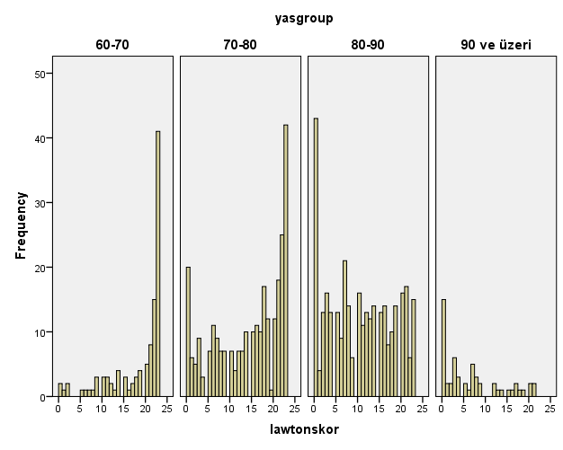
AGE GROUPS
AGE GROUPS
Barthel score
Lawton score
p value<,000
p value<,000

Slide 13
FUNCTIONAL LEVEL
Chi-Square Tests
 | Value | df | Asymp. Sig. (2-sided)
Pearson Chi-Square | 8,043ª | 6 | ,235
Likelihood Ratio | 8,291 | 6 | ,218
N of Valid Cases | 770
a. 0 cells (0,0%) have expected count less than 5. The minimum expected count is 12,14.

Slide 15
The corralation between barthel index and comorbid diseases:
Comorbidities | p value
Hypertension | ,001
Coronary Artery Disease | ,293
Chronic Obstructive Lung Disease | ,659
Cerebrovascular disease | ,001
Chronic Heart Disease | ,005
Peripheric Vascular Disease | ,103
Dementia | ,000
Parkinson’s Disease | ,000
Osteoarthritis | ,035
According to the Barthel index results, evaluated through diseases, the result of coronary artery disease, chronic obstructive lung disease and peripheric vascular disease (p>0.05) were insignificant.

Slide 16
The corralation between lawton index and comorbidities:
Comorbidities | p value
Hypertension | ,024
Coronary Artery Disease | ,695
Chronic Obstructive Lung Disease | ,452
Cerebrovascular disease | ,041
Chronic Heart Disease | ,000
Peripheric Vascular Disease | ,117
Dementia | ,000
Parkinson’s Disease | ,000
Osteoarthritis | ,182
According to the Lawton index results, evaluated by diseases, the results of coronary artery diseases, chronic obstructive lung diseases, peripheric vascular diseases and osteoarthritis (p>0.05) were insignificant

Slide 17
Coefficientsª
Model |  | Unstandardized Coefficients |  | Standardized Coefficients | t | Sig. | 95,0% Confidence Interval for B
 |  | B | Std. Error | Beta |  |  | Lower Bound | Upper Bound
1 | (Constant) | 136,217 | 10,262 |  | 13,274 | ,000 | 116,055 | 156,379
 | Age | -,632 | ,128 | -,206 | -4,929 | ,000 | -,884 | -,380
 | Comorbidity | -,019 | 1,931 | -,001 | -,010 | ,992 | -3,812 | 3,774
 | Gender | -3,519 | 2,109 | -,070 | -1,668 | ,096 | -7,663 | ,625
 | Education | ,550 | ,205 | ,107 | 2,684 | ,008 | ,147 | ,952
 | HT | -,689 | 2,916 | -,014 | -,236 | ,813 | -6,419 | 5,040
 | CAD | 1,028 | 3,071 | ,018 | ,335 | ,738 | -5,005 | 7,061
 | COLD | -7,824 | 3,786 | -,095 | -2,067 | ,039 | -15,261 | -,386
 | CVD | -5,389 | 3,421 | -,075 | -1,576 | ,116 | -12,110 | 1,331
 | CHD | -6,575 | 3,698 | -,092 | -1,778 | ,076 | -13,841 | ,691
 | PAD | -6,499 | 5,527 | -,049 | -1,176 | ,240 | -17,358 | 4,360
 | Dementia | -12,924 | 3,056 | -,229 | -4,229 | ,000 | -18,929 | -6,920
 | Parkinson's disease | -23,853 | 3,801 | -,294 | -6,275 | ,000 | -31,322 | -16,384
 | OA | -1,378 | 3,376 | -,020 | -,408 | ,683 | -8,011 | 5,256
a. Dependent Variable: bartelskor

Slide 18
Coefficientsª
Model |  | Unstandardized Coefficients |  | Standardized Coefficients | t | Sig. | 95,0% Confidence Interval for B
 |  | B | Std. Error | Beta |  |  | Lower Bound | Upper Bound
1 | (Constant) | 37,729 | 3,090 |  | 12,210 | ,000 | 31,658 | 43,800
 | Age | -,292 | ,039 | -,293 | -7,557 | ,000 | -,368 | -,216
 | Comorbidity | -,953 | ,581 | -,174 | -1,640 | ,102 | -2,096 | ,189
 | Gender | -,679 | ,635 | -,042 | -1,069 | ,286 | -1,927 | ,569
 | Education | ,272 | ,062 | ,164 | 4,406 | ,000 | ,150 | ,393
 | HT | 1,689 | ,878 | ,105 | 1,923 | ,055 | -,037 | 3,414
 | CAD | 1,067 | ,925 | ,058 | 1,154 | ,249 | -,749 | 2,884
 | COLD | ,979 | 1,140 | ,037 | ,859 | ,391 | -1,261 | 3,219
 | CVD | -,042 | 1,030 | -,002 | -,041 | ,967 | -2,066 | 1,981
 | CHD | -,984 | 1,114 | -,042 | -,884 | ,377 | -3,172 | 1,204
 | PAH | -,633 | 1,664 | -,015 | -,380 | ,704 | -3,903 | 2,637
 | Dementia | -5,277 | ,920 | -,289 | -5,735 | ,000 | -7,085 | -3,469
 | Parkinson's disease | -3,777 | 1,145 | -,143 | -3,299 | ,001 | -6,025 | -1,528
 | OA | 1,204 | 1,017 | ,053 | 1,184 | ,237 | -,794 | 3,201
a. Dependent Variable: lawtonskor

Slide 19
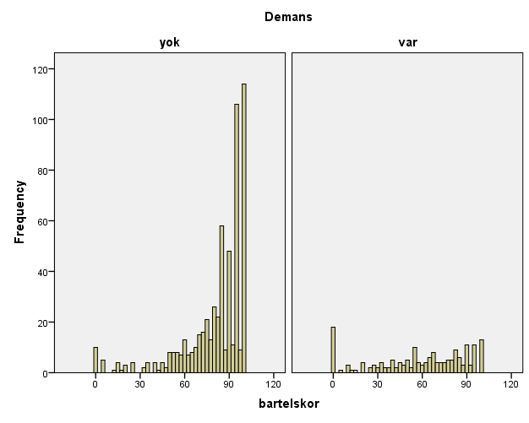
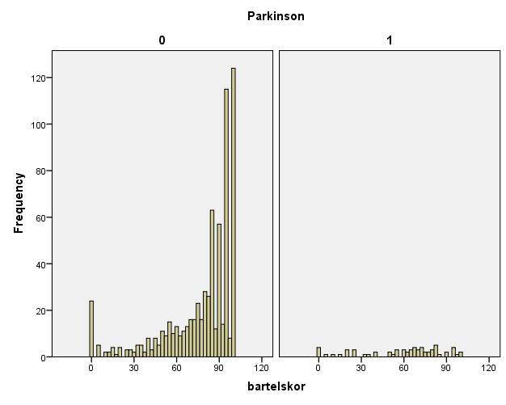
DEMENTIA
0
1

Slide 20
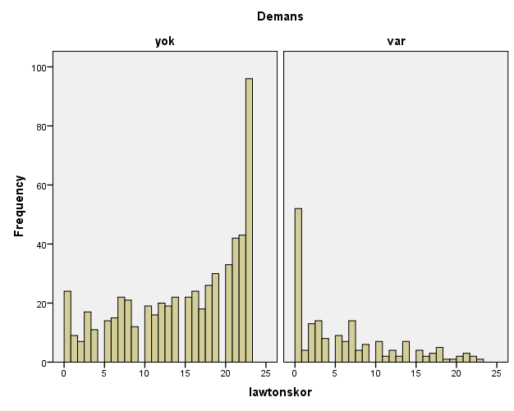
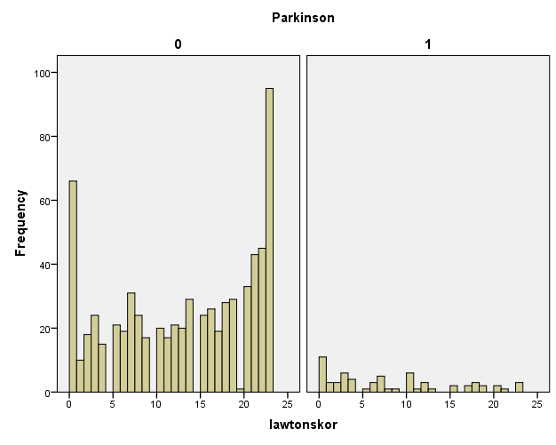
DEMENTIA
0
1

Slide 21
CONCLUSION
We found that urinary incontinence in activities of daily living causes similar problems in all age groups, but other activities worsen with age.
Dementia patiens have 13 times worse Barthel scores and 5 times worse Lawton scores
Parkinson’s disease patines have 24 times worse Barthel scores and 4 times worse Lawton scores.
We found that the other diseases does not cause a significant difference on scale scores.

Slide 22
References
W.A. Satariano, R.A. Silliman / Critical Reviews in Oncology/Hematology 48 (2003) 239–248
Kaya, D., Koçyiğit, S. E., Dokuzlar, Ö., Soysal, P., & Işık, A. T. (2018). Geriatri poliklinik olgularında geriatrik sendromlar: 1048 olgunun analizi. Ege Tıp Dergisi, 57(1), 31–35. doi: 10.19161/etd.414492
Repetto, Lazzaro, et al. “Comprehensive Geriatric Assessment Adds Information to Eastern Cooperative Oncology Group Performance Status in Elderly Cancer Patients: An Italian Group for Geriatric Oncology Study.” Journal of Clinical Oncology, vol. 20, no. 2, 2002, pp. 494–502., doi:10.1200/jco.2002.20.2.494.
Olin, A. Ö., Koochek, A., Ljungqvist, O., & Cederholm, T. (2004). Nutritional status, well-being and functional ability in frail elderly service flat residents. European Journal of Clinical Nutrition, 59(2), 263–270. doi: 10.1038/sj.ejcn.1602067
Talarska, D., Strugała, M., Szewczyczak, M., Tobis, S., Michalak, M., Wróblewska, I., & Tobis, K. W. –. (2017). Is independence of older adults safe considering the risk of falls? BMC Geriatrics, 17(1). doi: 10.1186/s12877-017-0461-0
Van der Vorst, A., Zijlstra, G. A. R., Witte, N. D., Duppen, D., Stuck, A. E., Kempen, G. I. J. M., & Schols, J. M. G. A. (2016). Limitations in Activities of Daily Living in Community-Dwelling People Aged 75 and Over: A Systematic Literature Review of Risk and Protective Factors. PLOS ONE, 11(10), e0165127. https://doi.org/10.1371/journal.pone.0165127
Moe, Aud & Enmarker, Ingela & Hellzén, Ove. (2012). Daily life for chronically ill oldest old persons. Nursing Reports. 2. 10.4081/nursrep.2012.e8.
Turkish Statistical Agency, 18 March 2021. Access: TÜİK Kurumsal (tuik.gov.tr)
Republic of turkey Ministry of Family, Labour and Social Services, 2020. Access: yasli-nufus-demografik-degisimi-2020.pdf (ailevecalisma.gov.tr)
Section 2402(a) of the Affordable Care Act—Guidance for ImplementingStandards for Person-Centered Planning and Self-Direction in Home and Community-Based Services Programs. Washington, DC: US Department ofHealth and Human Services, 2014

Slide 23
Acknowledgement
Assoc. Dr. Pınar Soysal
Gr. Gökçe Tan

Slide 24
THANK YOU!

Slide 25
Disease | + | -
Hypertension | %66,2 | %32,7
Coronary Artery Disease | %19,9 | %78,4
Chronic Obstructive Lung Disease | %8,3 | %90,3
Cerebrovascular disease | %12,3 | %86,2
Chronic Heart Disease | %11,2 | %87,4
Peripheric Vascular Disease | %3,4 | %95,3
Dementia | %27,8 | %70,5
Parkinson’s Disease | %8,3 | %90,3
Osteoarthritis | %11,8 | %86,5

Slide 26
Barthel | Dependant
Feeding | 71%
Bathing | 41%
Grooming | 46%
Dreessing | 15%
Bowels | 75%
Blader | 32%
Toilet use | 75%
Transfer | 21%
Mobility | 23%
Stairs | 16%
Lawton | Dependant
1.Ability of use telephone | 18%
2.Shopping | 43%
3.Food preperation | 34%
4.Housekeeping | 32%
5.Laundry | 41%
6.Mode of transportation | 12%
7.Responsibility of own medication | 29%
8.Ability to handle finances | 30%

Slide 28
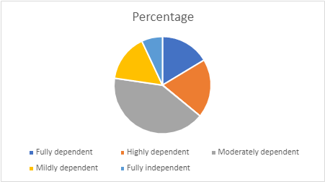
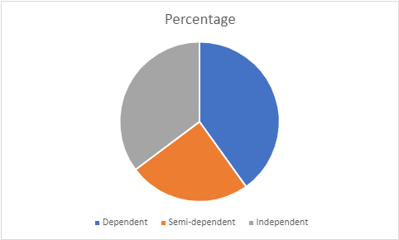
Barthel Index
Lawton Index

